Slide 1
Business processes bdat1003
Week 1:
Course Overview & Introduction to Business Processes-Big Data
Instructor:
Rick Lambroff

Slide 2
Today’s dISCUSSION
Course Overview
Introduction
Review of course learning objectives
Overview of course syllabus and assignments
Teaching philosophy for this course
What is Emotional Intelligence?
What personality type are you?
Videos: Business Process Modelling

Slide 3


Introduction
Bio of Instructor
Big Data Analytics Instructor- Business Processes & Data Analytics Project/Project Management-Communications/Computer Studies- Business Intelligence Tools & Business Intelligence & Analysis
2018 Georgian College-Big Data Analytics Graduate
18 + years in the Financial Markets
https://richardlambroff.wixsite.com/portfolio

Slide 4

Teaching pHILOSOPHY
Student Success
I am encouraged to see all of you do well in this course and the Big Data Analytics program!
Active & Experiential Learning
I believe in the value of active & experiential learning, meaning engaging students in “learning by doing”. As well mentoring, becoming confident when presenting and develop leadership skills. Remain resilient and use your time efficiently
Variety of Learning Activities
I will try to incorporate a variety of teaching methods to accommodate different learning styles / preferences (e.g., lectures, activities, videos, games)
Encouraging Community Connections
I also think that establishing connections with external organizations and experts, and gaining applied experience in the industry, is a big part of the benefits of a grad program

Slide 5

CLASS EXPECTATIONS & Policies
Attendance
Students are expected to attend and actively participate in class
Late Assignments
You are expected to submit your work on time
You must notify me in advance if an assignment will be late. Extensions will be granted only in exceptional circumstances (e.g., illness, family emergency). Late submissions will be subject to a penalty of -20% per day
Academic Misconduct
Misconduct will not be tolerated. This includes inappropriate in-class behaviour, plagiarism, and other violations of school policies.
Group Work Expectations and Policies
You are responsible for effective participation in your MRP teams and other group work. This will require good communication, planning, flexibility, patience, and commitment. If an issue cannot be resolved internally, you must notify the professor early on.

Slide 6
Course overview

Slide 7
course overview
LEARNING OBJECTIVES
Understand business processes and information needs
Identify and document business requirements, opportunities, and challenges for data analysis
Develop a business proposal & project charter that meets an organization’s need for data collection, analysis, and reporting
Design and present proposals, business process/data visualizations, and executive summaries for stakeholders
Apply basic entrepreneurial strategies to identify and respond to new opportunities and challenges
Objective of this course is designed to help you learn “the art and science” of developing a business proposal for a big data research project.

Slide 8
Assignment structure
Project Charter
Business Process Evaluation
Preliminary Research Plan
Ethical Considerations & Data Management Plan
Software Tool Evaluation
Peer feedback on MRP
MRP Presentation
Each course assignment are designed around the learning objectives, assisting you to understand the proposal development process from beginning to end.
Final MRP Proposal

Slide 9
Project cHARTER
First assignment to create a Project Charter/MRP Proposal (due 2nd of June 2023).
Project Charter provides a preliminary delineation of roles and responsibilities, outlines the project objectives, identifies the main stakeholders, and defines the authority of the project manager. It serves as a reference of authority for the future of the project.
The Project Charter assignment will set the foundation for your Major Research Project (MRP) proposal.
We will be discussing on how to create a Project Charter in class on 19^{th &} of May 2023.

Slide 10
MAJOR RESEARCH PROJECTS
MRPs are part of the applied learning model in BDAT
These projects span over the course of your two academic terms
The research for these projects can be completed in collaboration with community organizations from the private, public, and not-for-profit sectors.
Semester 1:
Proposal Development
Business Processes & Modelling (BDAT1003)
Semester 2:
Research Implementation
Data Analytics Project (BDAT1011)

Slide 11
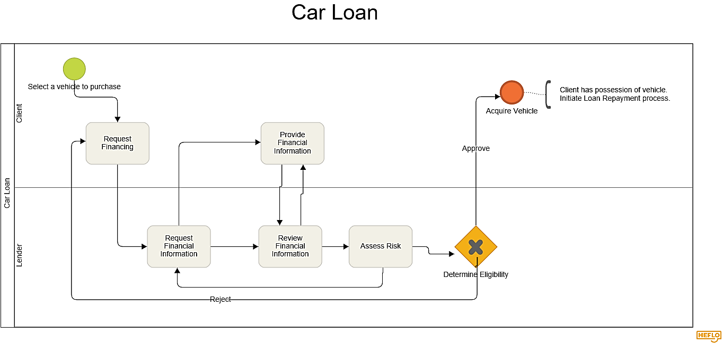
BUSINESS PROCESS VISUALIZATION
Once you have selected your project, the next step is to understand the business process underlying the data that you’re going to be working with.
We will be covering material from May 26th ; with your first “business process visualization due on June 9th.

Slide 12
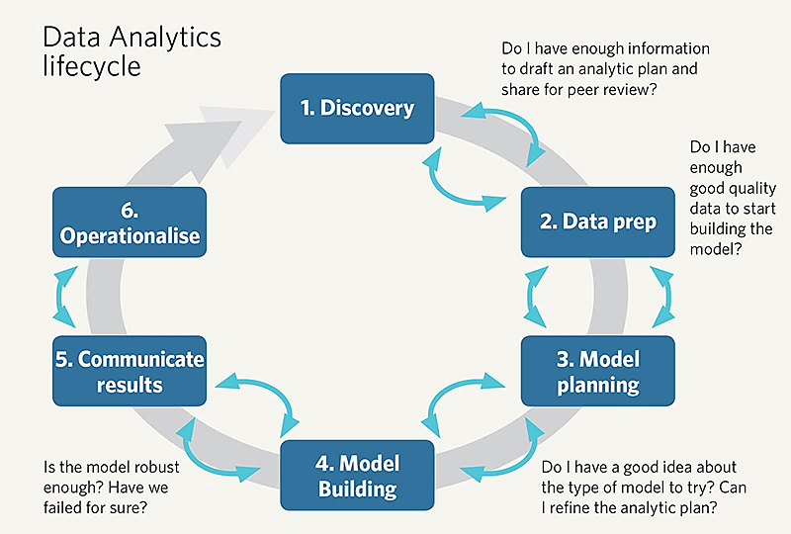
Modelling your own bpm
This type of visualization will be included as part of your preliminary MRP presentation. In addition to modelling your client’s process, you will also need to develop a business process model for how you’re going to go about the analysis you’ll be conducting.

Slide 13
Preliminary MRP pRESENTATION
The Preliminary MRP (Major Research Project) Presentation will build from your Project Charter, providing more detail about how you’re going to go about the research and analysis.
This will be an important step in helping you (and your client) figure out what’s feasible given the tools, techniques, and timeframes we have to work with.
We’ll cover what goes into the Preliminary MRP in class from Week’s 2-6 , and the presentation will be due on 23rd June 2023.

Slide 14
PRELIMINARY MRP Presentation
Introduction
Background about the topic
Why the project is being done and for whom?
Project Objectives
What’s the specific “research problem” being addressed?
What’s in and out of scope for this project?
What outcomes do you hope to achieve?
Business Process Visualization
How does the clients business process work?
Data Analysis Plan
How the analysis will be conducted (i.e., methods)?
What is your business process for doing the work look like?
Ethics and Data Management Plan
How will the ethical and management components be managed?
Preliminary Project Charter
What are you proposing to finalize as your binding contract with stakeholder?
Proposed suggestions
Your suggestions to improve or recreate for the business
Appendices
Reference list and other supporting materials
Note: Presentation submissions (video) on June 23rd
Evaluation breakdown is 10% written, 10% for the presentation for a total of 20% towards your final grade

Slide 15
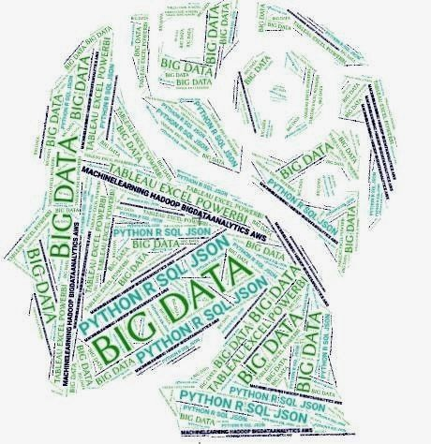
Career development
Along with all the work to prepare for this project, I would like to provide insight on how we can prepare for your career direction and job searches.

Slide 16

What is Emotional Intelligence?
Emotional intelligence refers to the ability to identify and manage one’s own emotions, as well as the emotions of others.
Complete online quiz:
https://www.mindtools.com/pages/article/ei-quiz.htm
Let’s discuss results and review.
16

Slide 17

What Personality Type are you?
https://www.16personalities.com/free-personality-test

Slide 18
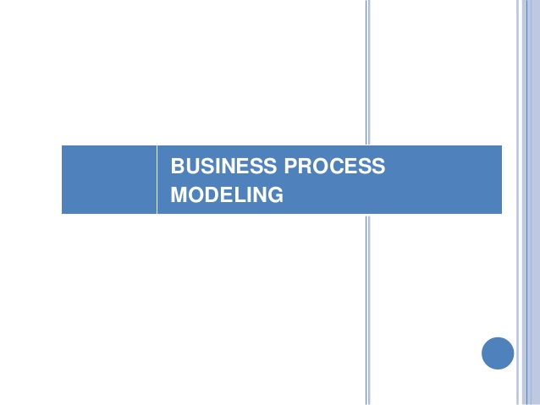
Videos:
These videos assist in the understanding processes pertaining to Business Process Modelling
I’m hoping that this information will:
Provide you with an overview of the areas in which Business Process is being utilized and how it is reshaping many industries
Inspire your work throughout this term, and perhaps give you some ideas for potential big data analytics projects
https://www.youtube.com/watch?v=NXbGIilFidA
https://www.youtube.com/watch?v=epokxGTkRSg

Slide 19

See you in week 2!!!

